Slide 1
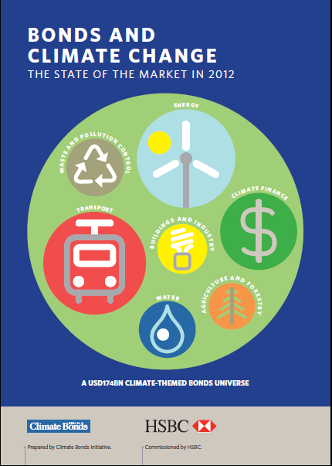
Bonds and climate change
The state of the market in 2012
Webinar | 11 & 12 July 2012
Notes:
Jeffrey Sachs: We are in deep trouble
We’re on the edge of catastrophe
Things are not working
We have squandered 20 years
We have to fully decarbonize
Emissions grew 6% last year
Bond market $100tn, Institutional investors $80tn
$20tn signed calls for action, green vs brown
But “no deal flow” (scale and rating), not liquidity
Confusion about what are “climate change investment” (where the deal flow will come from)
We have to transition to a low-carbon, climate resilient world
Investments that help us get there count
Inclusions / qualifying universe
How big is it already

Slide 2
A $174bn global universe
Investor interest in the links between bonds and climate change is growing
Research to provide a first estimate of value of outstanding bonds linked to climate solutions
The estimated value of bonds aligned to climate themes is more than 24 times the current supply of ‘green bonds’ from development banks
Transport and energy account for 85% of the total, largely rail and renewables
Europe is the largest issuer – but the USA is the most innovative with renewable project bonds and energy efficiency bonds
Further market growth can be accelerated through standardisation, aggregation and policy support

Slide 3
Background
In 2011 in Durban, a large group of insurers called for:
“a significant increase in global bond issuance to be dedicated to finance for an acceleration of the transition to low-carbon growth”
Aim of this report: Provide a first estimate of the extent to which the current bond universe is geared towards the climate economy
Commissioned by HSBC and written by CBI
Goes beyond MDB issuance of ‘green bonds’

Slide 4
Background
Answers 4 key questions:
  How big is the climate-themed bond market?
  What are the key investment themes?
  Where are the main regional markets?
  What is the market outlook?
Why is it important?
  Overcome perception of niche market
  Prove that investment area is nothing new, purpose is different
  Show how the universe is diverse: ratings, geographies, sectors

Slide 5
Why bonds and climate change
First bonds issued with an explicit ‘green’ mandate in 2007
Investor interest in the links between bonds and climate change is growing
$10tn in cumulative investment in low-carbon energy required 2010-2020
Bonds are well-suited for long-term infrastructure investments required for a low-carbon, climate resilient economy
  High capex, low running cost
  Strength of climate policies in some regions leading to rapid cost reductions in wind, solar = more mature and stable market suited to bonds, like rail
  Recapitalisation pressure / Basel III discouraging banks from holding longer-term debt. Using debt capital markets frees up bank capital for project lending

Slide 6







Methodology – 7 key climate themes
Energy
Renewable energy, nuclear, biomass
for heat & electricity
Buildings
& industry
Techn & projects to improve energy efficiency of buildings & industry
Transport
CO2 efficient transport, rail, EVs,
biofuels
Finance
Green-labelled MDB programs, transport finance
Water
Sustainable water mgmt, techn, infrastructure
Waste & pollution control
Recycling services/
products, emissions reduction equip
Agriculture & Forestry
Paper & wood,
forest mgmt, organic seeds & fertilizers

Slide 7
Methodology
Fully aligned
Total
corporate
&
municipal
bond
universe
Thematic screen
Potential thematic universe
Individual screen
Strongly aligned
Thematic Bond universe
2005 cut off
Cross check
Conditional
Weakly aligned
Include MDBs and missing companies from other lists
Notes:
Step 1)
Large thematic screen using key words for each theme,
Highlight only companies which issue bonds
Identify bonds issued only since 2005
Step 2)
Read through description of each bond to double check alignment with theme – classified bonds as fully, strongly and weakly aligned
Read through company disclosure where unclear
Cross check with other lists – e.g. HSBC index, muni bond lists and MDB list
Step 3)
Clean up and filter bonds ONLY with 100% revenue dedicated to climate themes

Slide 8
Bond universes
Fully aligned bonds
100% revenue dedicated to climate themes OR 100% generation capacity + Municipal bonds + MDB green bonds + project bonds
Thematic Bond universe
Strongly aligned
>50% revenue exposure to climate themes OR > 50% generation capacity
Conditionally aligned
Bonds linked to activities either where data is unavailable (e.g. biofuel feedstock) OR
where there is currently a lack of definitional clarity (e.g. water utility)

Slide 9
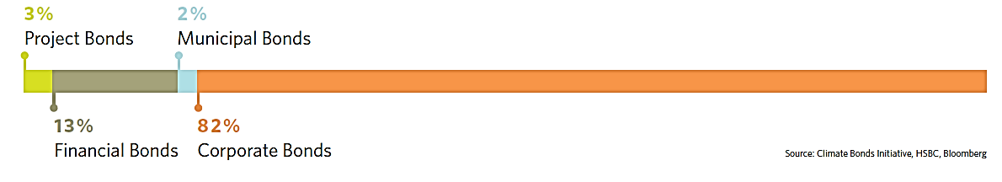
Results: overall
100% conditional activities
Revenue = 100%
Revenue > 50%
$375bn
Conditionally aligned
$174bn
Fully aligned
$204bn
Strongly aligned
Notes:
Animation: click to see each universe
The climate economy is split into 3 universes
Fully aligned: all revenue is derived from climate solutions
Strongly aligned: greater than 50% derived from climate solutions
Conditionally aligned: Role in the climate e
Over 1000 bonds issued by more than 200 issuers
conomy is conditional on other factors (e.g. water utility inclusion dependent on footprint of utility)

Slide 10
Thematic breakdown: Fully aligned
$174bn
Fully aligned
Notes:
Transport dominates – this is made up primarily of rail and is not surprising. Bonds have been used to finance rail for decades and are trusted and established – bonds to finance cleaner infrastructure is comparitively new and therefore not yet widely used to raise financing.

Slide 11
Thematic analysis
Energy $29bn:
Wind 38%, solar 28%, hydro 21%, other renewables 10%, nuclear 3%.
Waste &pollution $1.2bn: Mostly recycling services
Transport $119bn:
Almost all rail bonds
Agriculture & forestry $734m:
Includes sustainable timber/paper and organic seed/ fertilizers
Buildings & Industry $1.5bn: Majority LED firms and US municipal Qualified Energy Conservation Bond (QECB)
Finance $22.4bn:
Dominated by MDBs and Eurofima
Water:
No fully aligned bonds, $196B conditional

Slide 12
Geographic split
$30.4
bn
$14.2bn
$6.7bn
$6.6
bn
$40.4
bn
$27.6bn
$ 6.1bn
ROW
$25.2bn
Notes:
European issuance accounts for 2/3 of total.
UK =23%; France =17
Russia, Canada and China all at c3% each.
 Europe: Europe’s position explained by rail infrastructure. But large utilities are now starting to tap the bond market to finance renewable energy. The most notable project bond issuance was the partially guaranteed USD260mn Andromeda solar bond, issued at the end of 2010. The EU has also established a project bond initiative to channel public funding into the enhancement of credit ratings for energy, transport and ICT infrastructure.
 USA: 3rd highest issuer of climate-themed bonds. A key feature is the municipal market and we expect US states will look to issue public revenue bonds to finance further investments in water resource management and clean energy. The solar project bond market could also grow on the back of the successful Topaz offering – a USD850m bond issued in 2012 with no
government guarantees. However, a promising market in Property-Assessed Clean Energy (PACE) bonds is currently slowed by
a Federal Housing Finance Agency ruling.
 China: A growing renewables sector= 80% of total USD6bn. Issuance by renewable energy companies increased fourfold in 2011 to USD4.3bn. The offshore renminbi bond market in Hong Kong could see future issuance from state-owned rail companies as well by large energy conservation groups and renewable manufacturers. Four local governments – Guangdong, Shanghai, Zhejiang and Shenzhen – have also received the green light to pilot municipal issuance this year, pointing towards opportunities of linking low-carbon city development to the bond market.

Slide 13
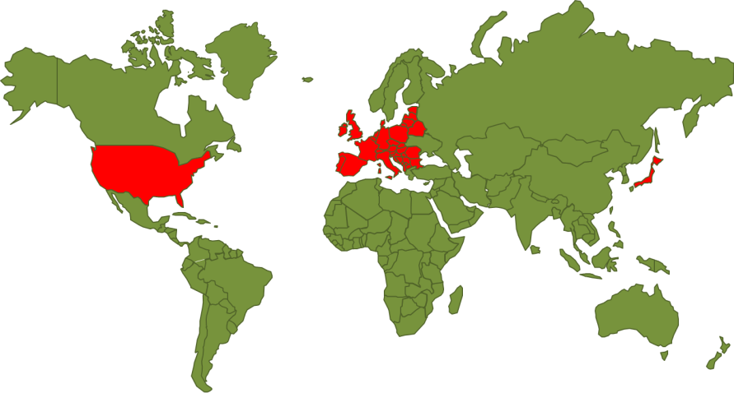
Europe, USA & Japan
Europe accounts for two-thirds, dominated by rail
  Focus on credit-enhancing infrastructure bonds
  Power utilities linking issuance
  Potential for energy efficiency bonds: UK Green Deal
USA: project & municipal bond leadership
  Large issuances (>0.5bn) from: Topaz Solar; Genesis Solar; Desert Sunlight; Alta Wind; Shepherds Flat
  California potential for water bonds
Japan: a key source of demand
  USD1bn of fully-aligned bonds compared to USD52bn of ‘strongly aligned’ (hydro, nuclear)
  Demand from Uridashi market (World Bank bonds)
  Future potential for renewable bonds with new Enerkan

Slide 14
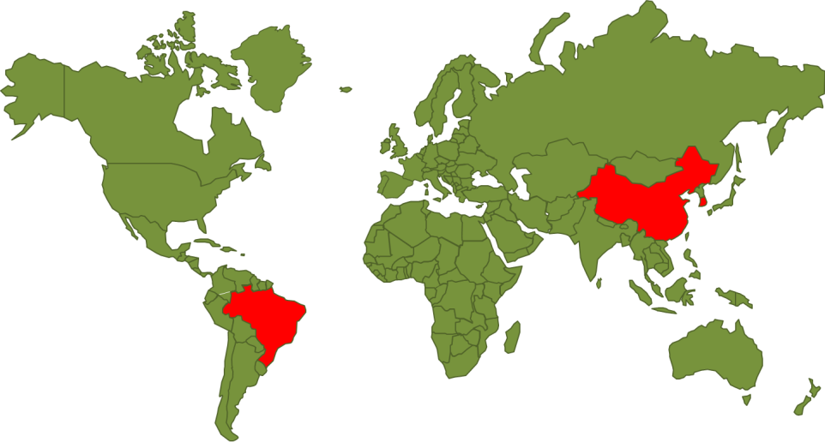
Emerging Economies:
China, Brazil, South Korea
China: Renewables contributed 80%
  Wind and solar corporate issuance increased x4 in past year
  Pilot municipal issuance could be linked to low-carbon cities:
Brazil: potential expansion ahead
  National development bank, BNDES, at forefront of climate financing
  REDD bonds remain a possibility
South Korea: green growth
  Low issuance to date of climate-themed bonds
  Growth through Green Growth plan w
  Incentives for bonds with >60% of capital towards certified firms/projects

Slide 15
Potential areas for growth
$665bn
$130bn
Energy
$163bn
Waste
$174bn
Current
Fully aligned universe
$174 Billion
Fully aligned
$197bn
Water
Notes:
Current size of the market is 174B but there is potential for it to grow significantly most notably:
Energy strongly aligned universe
Water: conditionally aligned universe
Waste: conditionally aligned universe
Water would include utilities + munibonds
Waste would include pollution control bonds

Slide 16
Challenges and areas for more work
Water utilities
  Classifying energy-intensive water utilities
  Identifying flood control integrated water management
  Understanding best available technologies (BAT)
  Understanding/measuring efficient water provision
Waste
  Clearer disclosure on use of different waste disposal techniques
  Understanding of carbon footprint of WTE vs Landfill
Notes:
Talk about some examples here

Slide 17
Conclusions and way forward
The existing market is a lot broader and deeper than anyone thought.
It will grow; but we need to accelerate it. That means:
1. Standardization (commoditization makes it easier for investors)
  Key priorities: Waste and water sectors
2. Aggregate for scale
  Scale is necessary to tap the institutional investor market
  Currently, there are only 103 bonds over the $500m threshold
3. Support to get investment-grade ratings
  Add scale & liquidity with public climate-themed bonds (eg Australia CEFC)
  Provide fiscal support (eg US clean energy bonds)
  Use public finance to enhance credit (eg EU project bond initiative)
The funds are there and there’s even a nascent market. We now need to generate deals
that suit the needs of bond buyers
Notes:
The existing market is a lot broader and deeper than anyone thought.
There is enough product right now to build climate-themed portfolios
To address climate change a huge investments will be required

Slide 18
www.climatebonds.net
bridget.boulle@climatebonds.net

