Slide 1
An Introduction to Climate Bonds Programmatic Certification Process
January 2019 © Climate Bonds Initiative

Slide 2
What is Programmatic Certification?
Programmatic Certification is a streamlined process for Issuers who plan to issue multiple green bonds over an extended period, against a large portfolio of eligible assets and projects.
It shares the same rigor as the basic Climate Bonds Certification process under the Climate Bond Standard and provides the same assurance, however it frontloads some of the procedures so that they are done only once in the beginning of the overall bond issuance programme.
Once the Issuer issues the first bond, after it is Certified, the Issuer can issue again, as and when they like, with a much simpler Certification procedure, backed up by annual verification of the programme.
Programmatic Certification is particularly suitable for Issuers with existing debt programmes and capability seeking a process to support an ongoing series of green bonds.

Slide 3
Programmatic Certification – who is it for?
Issuers who have a large portfolio of green assets and projects against which they plan to issue multiple bonds over a period of multiple years.
This includes sovereigns and sub sovereigns, banks, large corporations, public authorities and private utilities in transport, energy, water and waste, cities and municipalities.
The Issuer needs to identify the list of assets and projects at the beginning of the programme, which will be checked during the pre-issuance verification
Here are some of the existing issuers who have adopted this process: New York MTA, New York HFA, SNCF Réseau, Contact Energy, Société du Grand Paris, San Francisco Public Utilities Commission, Westpac, National Bank of Australia, Bay Area Rapid Transit (BART) and Los Angeles MTA.

Slide 4
How Programmatic Certification Works
Before the first green bond is issued, the Issuer engages a Verifier to review the first bond for pre-issuance and post-issuance, as in the regular process for Certification. The assets and projects to be used over the future bond programme are verified as part of this process.
When the Issuer issues the second bond, it can simply get Certified without requiring involvement of the Verifier before the issuance.
From the second year onwards, once a year, the Issuer must engage a Verifier to perform post-issuance verification of the bonds issued within that year and the overall programme.
Programmatic certification is also available for issuers who have already issued a Certified Climate Bond and wish to issue more bonds in the near future. As we have confidence of their disclosure and compliance structures, we would very much welcome them to continue issuing Certified Bonds under this streamlined process. They can engage a Verifier to verify the proposed portfolio of eligible assets and projects annually.

Slide 5
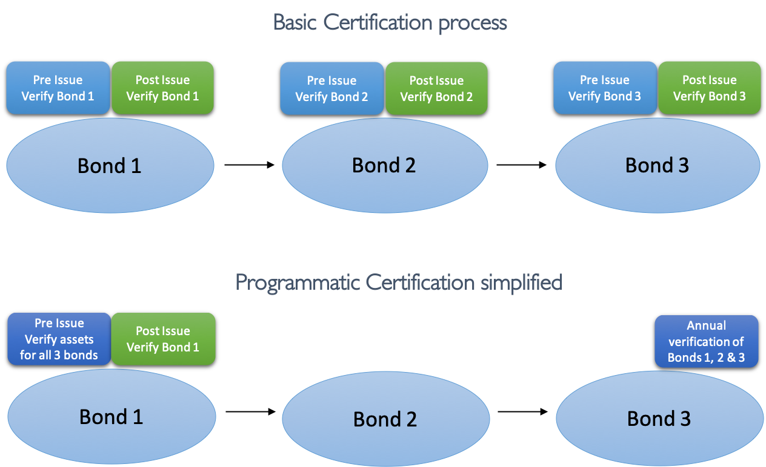
Programmatic Certification – Differences Compared

Slide 6
Programmatic Certification Streamlines Basic Certification
Basic Certification procedure for 3 bonds over 18 months
First bond requires pre-issuance verification and after the bond is issued, post-issuance verification is conducted
Second bond requires pre-issuance verification and after the bond is issued, post-issuance verification is conducted
Third bond requires pre-issuance verification and after the bond is issued, post-issuance verification is conducted
Programmatic Issuance for 3 bonds over 18 months
First bond requires pre-issuance verification and after the bond is issued, post-issuance verification is conducted
Second bond requires only provision of bond details for Certification
Third bond requires only provision of bond details for Certification
Annual verification covers all of the bonds and the overall programme

Slide 7
Programmatic Issuance – Case Studies
New York Metropolitan Transport Authority, New York
8 bonds to date – total USD 5,727 million
Our biggest Programmatic Issuer so far, the New York authority oversees a large transport system. They began their Programmatic bond issuance in February 2016.
The proceeds finance their operations and investment of the New York subway network, which is automatically eligible under the Low Carbon Transport Criteria.
NY MTA has an extensive debt issuance programme. Programmatic Certification is applied to only a portion of their overall debt raising, existing alongside their traditional ‘vanilla’ bonds.

Slide 8
Programmatic Issuance – Case Studies
New York State Housing Finance Agency, USA
10 bonds so far – USD 998.5 million
HFA finances development of affordable housing in New York State by New York State Homes and Community Renewal.
In 2016, they announced a Green Bond Programme which will finance their future housing projects, with units meeting certain energy efficient thresholds.
HFA have received Programmatic Certification for future buildings. Any of their future bonds financing buildings that meet the Low Carbon Buildings Criteria will be Certified.
So far, these bonds have contributed to financing several thousand housing units. They have plans to continue issuing Certified Bonds at the rate of several a year.

Slide 9
Programmatic Issuance – Case Studies
SNCF Réseau, France
4 bonds to date – EUR 3,150 million
SNCF Réseau manages the rail network infrastructure across France, including 35,000 km of track.
The network supports electric passenger trains which is eligible for Certification under the Low Carbon Transport Criteria.
They undertook Programmatic Certification in November 2016 for investment in new railway infrastructure and maintenance operations, the first French green bond issuer to adopt the PC process.

Slide 10
Programmatic Issuance – Case Studies
Contact Energy, New Zealand
Multiple bonds so far – NZ$ 1.8 billion
Contact Energy is a leader in geothermal power generation in New Zealand with over 350MW of generation capacity. It has developed a Green Borrowing Programme with a mix of debt instruments worth NZ$1.8bn to support the financing of its facilities.
In August 2017, this programme received Certification under the Geothermal Energy Criteria.
This was treated as post-issuance Certification, so that all of the prior debt instruments in this financing programme were also Certified together with any future debt instruments issued to finance the geothermal energy facilities.

Slide 11
Programmatic Issuance – Case Studies
San Francisco Public Utilities Commission (SFPUC)
5 bonds so far – USD 1,412 million
SFPUC is a government entity that is responsible for managing water supplies and distribution in San Francisco County and the region.
They have received Programmatic Certification for two bond programmes which finance their investments and operations in the Wastewater Investment Programme and the Drinking Water Investment Programme.
Both have received Certification under the Water Infrastructure Criteria.

Slide 12
Programmatic Issuance – Case Studies
Westpac, Australia
4 bonds so far – USD1,040 million equivalent
One of the ‘Big 4’ banks in Australia and a Certified Bond Issuer since May 2016.
Westpac has issued bonds in the Euro market, Japanese private placement & launched a Green Deposits product.
In 2017 Westpac received Programmatic Certification for all their existing bonds and the programme of issuances in the future.
Westpac has an annual verification process in place to confirm the Certification of the individual bonds and deposits, and the overall programme.
The projects and assets meet the Wind, Solar, Low Carbon Buildings, and Low Carbon Transport Criteria.

Slide 13
Programmatic Issuance – Case Studies
National Australia Bank (NAB), Australia
USD 2,010 million to date
NAB is one of the ‘Big 4’ banks in Australia.
As a large bank with diverse loan portfolios, they have received Programmatic Certification for two different Certified Bond Programmes.
One is the NAB Residential Mortgage Backed Securities Trust (RMBS), where the Certified bond refinances residential mortgages linked to buildings which meet the Low Carbon Buildings Criteria.
The other is their SDG Green Bond Programme, which refinances loans related to the Solar, Wind, Low Carbon Transport, Marine Renewable Energy, Low Carbon Buildings (Commercial) Criteria

Slide 14
Programmatic Issuance – Case Studies
Société du Grand Paris (SGP), France
One bond so far – EUR1.75 billion
The state-owned entity is executing the ‘Grand Paris Express’ project by the 2030s. This ambitious plan is the largest infrastructure project in Europe including 200kms of new metro and commuter rail lines and 68 new rail stations, compared to the existing 400kms network.
The Project aims to deliver on the SDGs and the low carbon ambitions of the government.
Fully electric network is eligible under the Low Carbon Transport Criteria.
The total estimated final size of the programme is worth EUR 35 billion. They issued their first Certified Bond in October 2018 and now are in the process of issuing another Certified bond.

Slide 15
Summary
Streamlined process for repeat or multiple green bond issuers
Maintains existing rigor of Certification against Climate Bonds Standard
Now established in the market and currently in use by 10 large issuers since launch in 2016
Further information available at www.climatebonds.net
Individual briefings available from senior Climate Bonds Certification staff

Slide 16
To find out more:
Rob Fowler Head of Certification Climate Bonds Initiative Australia: +61 402 298 569 rob.fowler@climatebonds.net | Matteo Bigoni Certification Manager Climate Bonds Initiative London: +44 (0) 7850 390 261 matteo.bigoni@climatebonds.net

Slide 17
Disclaimer: The information contained in this communication does not constitute investment advice in any form and the Climate Bonds Initiative is not an investment adviser. Any reference to a financial organisation or debt instrument or investment product is for information purposes only. Links to external websites are for information purposes only.
The Climate Bonds Initiative accepts no responsibility for content on external websites. The Climate Bonds Initiative is not endorsing, recommending or advising on the financial merits or otherwise of any debt instrument or investment product and no information within this communication should be taken as such, nor should any information in this communication be relied upon in making any investment decision.
Certification under the Climate Bond Standard only reflects the climate attributes of the use of proceeds of a designated debt instrument. It does not reflect the credit worthiness of the designated debt instrument, nor its compliance with national or international laws.
A decision to invest in anything is solely yours. The Climate Bonds Initiative accepts no liability of any kind, for any investment an individual or organisation makes, nor for any investment made by third parties on behalf of an individual or organisation, based in whole or in part on any information contained within this, or any other Climate Bonds Initiative public communication.

